Slide 1



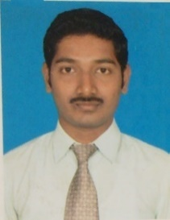
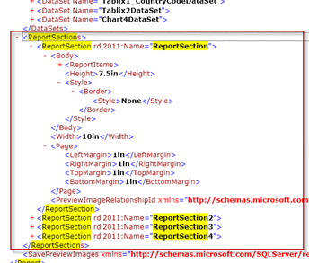
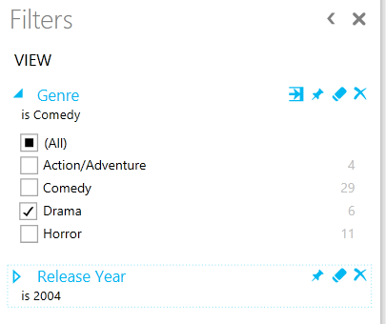
Master Data Management
Microsoft BI-focal lens
Passing parameters to Microsoft Power View
Scenario : How can we pass default parameter for PowerView report hosted in Sharepoint 2013.
Nagaraj Sengodan has around 11 years of core work experience in DW/BI practice. He performed advisory role on complex Business Intelligence projects and architected Business Intelligence solutions and led the development of comprehensive dashboards, analytical reports.
Consider a scenario where customer want some default parameter to be passed while opening the SharePoint 2013 powerview report (.rdlx). This is challenging as there is no direct options available and not much advance options available to do so. We can achieve this using URL parameter.
Sample Picture/Screenshot
Step 1: .rdlx file refers to each page of powerview report mentioned as report section.
Step 2: Add corresponding page number in the report section parameter (refer left side image)
ReportSection=ReportSection2
Step 3: Add report default /custom filter parameters as mentioned below
&rf=[Table Name].[Field Name] eq 'Value‘
i.e: &rf=[Media].[Genre] eq ‘Drama'&rf=[Media].[Release Year] eq 2004
Step 4: Refer the left side image for after apply this url filter in the power view report (.rdlx)
Step 5: Please find the below some important parameter data type and their respective method to pass in URL and escape characters details.
Data types
String
&rf=[City].[Name] eq 'Sydney'
Numeric
&rf=[Time].[Year] eq 2013
&rf=[Sale].[Price] eq 19.99
Date
&rf=[Sale].[Date] eq datetime'2013-02-25'
&rf=[Sale].[Date] eq datetime'2013-02-25T12:34'
&rf=[Sale].[Date] eq datetime'2013-02-25T12:34:17.0001'
Boolean
&rf=[Resource].[Active] eq true
Blank or null values
&rf=[Something].[Else] eq null
Escaping characters
&rf=[Region].[State Province] eq '河南'
Into
&rf=[Region].[State Province] eq '%E6%B2%B3%E5%8D%97'
Use double '' to escape quotes
&rf=[Region].[City Name] eq 'O''Fallon'
This content has been created by BAS – Microsoft Practice – powered by Microsoft Special Interest Group.
For any queries or nominations please write to bas.microsoft@hcl.com or elayaraja.e@hcl.com or sudripta.rakshit@hcl.com

